Slide 1

Escalation straight-up: ESCALATION MANAGEMENT MODULE
Alabado, Matthew Arnold
Alconcel, Alanis Watz
Balubal, Samantha Nicole
Brillantes, Rachel Anne
Burton, Kathrine Danielle
Pamittan, Engel-Jan

Slide 2

Overview
Introduction
Objectives
Scope and Limitations
Related Systems
Gap Analysis
Proposed System

Slide 3
INTRODUCTION
Client: Taal Vista Hotel
Problems:
Unattended service requests
Limited escalation process
Solution:
Escalation module

Slide 4
General OBJECTIVES
Develop a solution for Taal Vista Hotel that will produce effective escalation process

Slide 5
Specific OBJECTIVES
Gather and analyze escalation data
Develop an Escalation Management Module
Generate reports to further improve quality management of the hotel

Slide 6
SCOPE
Module will be initiated by an escalated service ticket
Generate escalation reports from data gathered on the escalation process.

Slide 7
SCOPE
Target Users:
4
2
1
3
General Manager
Resident Manager
Department Manager
Supervisor

Slide 8
LIMITATIONS
Limited within the quality aspect of services
When the action needed on the service-related requests must be done by the expertise of a third party

Slide 9
Related Systems
System Name | Common Features | Unique Features
KNOWCROSS (Know Glitch) | Real-Time Communication | Hotel Management Software
HotelTap | Real-Time Communication | Analytic Dashboard Mobile notification for instant communication among employees
FCS Computer Systems (Guest Services) | Mobile-Enabled Task escalation | Smart Escalation
ALICE (STAFF) | Mobile-Enabled Ticketing System Task-Tracking System | Assignment of tickets Displays ticket status and owner Simple User Interface

Slide 10
Related systems
System Name | Common Features | Unique Features
Guest Experience Software System (GESS) | Task Escalation | Automatic Alert that notifies the employees
HotelMGR | Mobile-Enabled Task-Tracking System | Request Prioritization
Oracle Escalation Management | Task-Tracking System | Ownership assignment De-escalation and closure Automatic notification (escalation progress)
Escalation Straight-Up | Mobile-Enabled Task escalation Assignment of tickets | Notification alert Hierarchy level of senior employees for escalation process of unattended service tickets

Slide 11
GAP ANALYSIS
User Requirements | Current System | Proposed Changes
1. Gather escalation data | Issues are recorder by the Guest Service Center using Freshdesk and Excel | Develop an escalation management module that does the following: Automatically gathers all the escalation data entered in to the module
2. Improve escalation process | Limited escalation processes | Develop an escalation management module that does the following: Receives service tickets which exceeds within the given SLA Re-assign to the senior employee level

Slide 12
GAP ANALYSIS
User Requirements | Current System | Proposed Changes
3. Identify how services can be improved through an escalation process | Limited escalation processes | The escalation management module can do the following: Generates an escalation report that can be used by the executive management for decision making
4. Ease of notification via hand-held devices | Means of communication between employees: Walkie Talkie | Escalation management module will be a mobile application Assigned employee on the hierarchy level of the module will be notified regarding the escalated service tickets

Slide 13
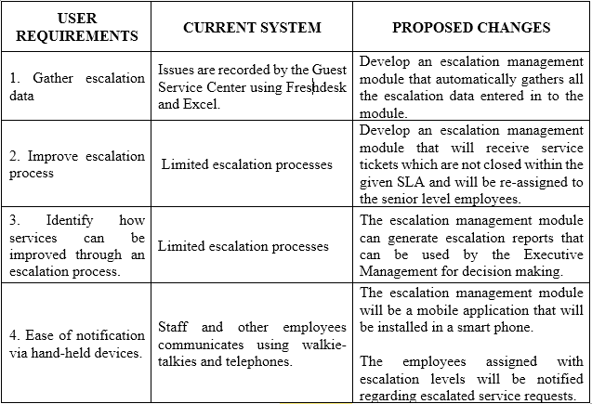
GAP ANALYSIS

Slide 14
Proposed system
Systems Overview
Use Case
Context Flow Diagram

Slide 15
Systems overview
Receive: Unattended service tickets
Hierarchy Level:
Level 1 – Supervisor (SP)
Level 2 – Department Manager (DM)
Level 3 – Resident Manager (RM)
Level 4 – General Manager (GM)

Slide 16
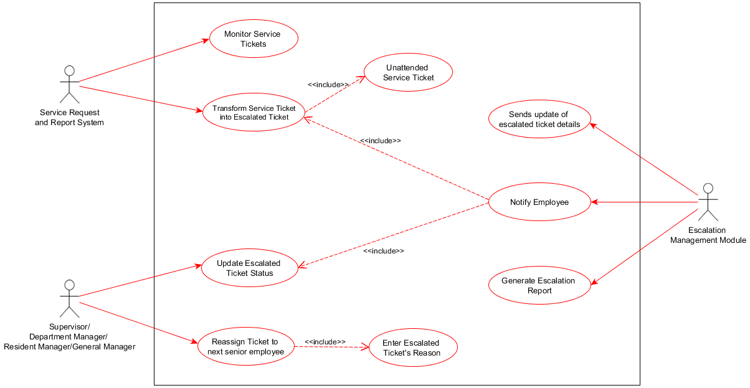
Use case
Notes:
Service request and report system is responsible for monitoring the service tickets and transform it into an escalated ticket. However, this process cannot be done without an unattended service ticket.
Once the unattended service ticket became an escalated ticket, the escalation management module notifies the Level 1 senior employee which is the Supervisor – the supervisor must update the escalated ticket status for it to considered by the module as an In-progress ticket and also to activate the timer. If the Supervisor failed to close the ticket and exceeds by the given time, it automatically notifies and re-assign the ticket to the next level of senior employee which is the Department Manager. Previous owners of the ticket must enter an escalated ticket’s reason.
Once the tickets closed, the module sends an update of escalated ticket details to the Service Request and Report System and generates an escalation report which displays a graphical representation of how many times a certain nature of service were escalated.

Slide 17
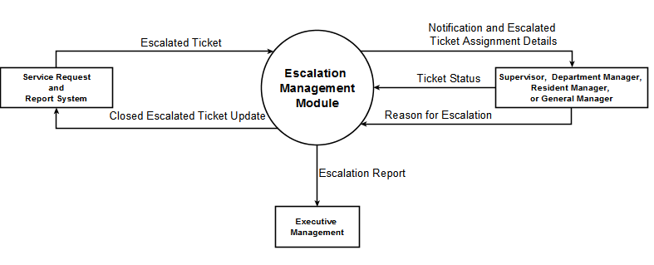
Context flow diagram

